Slide 1
CSCI E-101
Discussion 8
Midterm Review

Slide 2
Midterm Review
1) Statistics Formulas covered in class
a. (mean, std dev, covariance, Pearson R)
2) Python Basics
a. Data types
b. Expressions
c. Relational and logical operators
d. If-elif-else, for loop, while loop
e. String slicing, string functions
f. Call by values and reference
3) Python Modules and Functions covered in class
a. Pandas, numpy, user-defined-functions,
b. Pandas data frame, save to CSV, read from CSV
c. MySQL connector, cursor and Pandas MySQL integration
d. Executing SQL commands from Python
i. SHOW, CREATE, DROP, SELECT, UNION, INSERT INTO, COMMIT
e. Python filtering, replace, regex, pivot, pivot table
f. All Pandas dataframe creation, data cleaning, merge concepts and techniques covered
in class

Slide 3
Midterm Logistics
Treat as a pencil and paper exam, try not to debug code in IDE unless you have extra time
90 minute exam, be mindful of the Canvas countdown timer, exam must be submitted at the end of the exam
Read all questions prior to starting on the midterm. Midterm is designed to be lengthy to test the knowledge of content covered in class up to Module 7 (Data Visualization and Storytelling will not be on the midterm)
Zoom proctored exam
Must have webcam on
You may use resources available to you without physically leaving the testing area
Some logistical questions may be answered via zoom chat
Times offered for the exam https://www.surveymonkey.com/r/midtermsignup
Tuesday, November 2, from 8:00 am to 9:30 am ET (2nd choice)
Tuesday, November 2, from 3:00 pm to 4:30 pm ET (1st choice during class time)
Tuesday, November 2, from 5:30 pm to 7:00 pm ET (3rd choice)
Tuesday, November 2, from 11:00 pm to 12:30 am ET (Last choice)
Mock Midterm
Midterm Practice Exam - "dress rehearsal" on Saturday, October 30th, at 10:00 pm ET

Slide 4
Midterm Formula Sheet
Statistical formulas covered in class
https://docs.google.com/document/d/1WJvmFPc9KQI1NtBYjWdjnmMukPQ-kTpcC9Cp__ie1Aw/edit?usp=sharing

Slide 5
Recommended Review
Python basics
data types, expressions
operators; control structures; slicing (arrays string)
User defined functions
filtering, replace, regex, pivot table
data frames/series
Stats
Review your formulas
mean, stddev, variance, covariance, z-score
SQL
mysqlconnector, SHOW, CREATE, DROP, SELECT, UNION, INSERT INTO, COMMIT

Slide 6
Data Types
Type | 411
str | sequence of characters
int, float | numbers
list | array++
tuple | immutable list
set | O(1) unique item list
dict | O(1) super fast key / value pair-based data structure

Slide 7
Python Basics
list comprehension: [i for i in range(1,1000)]
list comprehension with if/else: [i/10 if i > 50 else 0 for i in range(0, 1000)]
dict comprehension: {i:i*2 for i in range(1,1000)}
Slicing:
>>> a = [1,2,3,4,5] >>> a[:1] + a[1:] [1] + [2, 3, 4, 5] >>> a[-1] 5

Slide 8
List Comprehension
Original
my_list = []
For item in original_list:
my_list.append(item * 2)
list comprehension:
my_list = [item * 2 for item in original_list]

Slide 9
Expressions
50/10 ---> (5.0)
/ = float division ;
// = floor (int) division
** exponentiation
is
not
in
50//10 ---> (5)
>>> 10**2 100
>>> a is None False
>>> a is not None True
>>> a = ["uno", "dos", "tres", "cuatro"] >>> "one" in a False

Slide 10
Built in Functions
abs() | delattr() | hash() | memoryview() | set()
all() | dict() | help() | min() | setattr()
any() | dir() | hex() | next() | slice()
ascii() | divmod() | id() | object() | sorted()
bin() | enumerate() | input() | oct() | staticmethod()
bool() | eval() | int() | open() | str()
breakpoint() | exec() | isinstance() | ord() | sum()
bytearray() | filter() | issubclass() | pow() | super()
bytes() | float() | iter() | print() | tuple()
callable() | format() | len() | property() | type()
chr() | frozenset() | list() | range() | vars()
classmethod() | getattr() | locals() | repr() | zip()
compile() | globals() | map() | reversed() | __import__()
complex() | hasattr() | max() | round()

Slide 11
Operators
Operator | Purpose | Usage
& | returns 1 if both the corresponding bits are 1 | a & b
| | returns 1 if any of the corresponding bits is 1 | a | b
~ | inverts all of the bits | ~a
^ | returns 1 if any of the corresponding bits is 1, but not both | a ^ b
>> | shifts the bits of ‘a’ to the right by ‘b’ no. of times | a >> b
<< | shifts the bits of ‘a’ to the left by ‘b’ no. of times | a << b

Slide 12
Pandas I/O
From DB
db_connection = sql.connect(host='127.0.0.1', database='employees', user=MYUSER, password=MYPASS)
salaries_df = pd.read_sql("""select * from salaries AS s inner join employees as e using (emp_no) limit 1000""", con=db_connection)
To CSV
salaries_df.to_csv("test.csv",index=False)
From CSV
salaries2_df = pd.read_csv("test.csv")

Slide 13
Pandas Filtering
my_filter = (salaries_df["from_date"]>datetime.date(2000,1,1)) & (salaries_df.first_name.str.contains("^G"))
salaries_df[my_filter]
 | emp_no | salary | from_date | to_date | birth_date | first_name | last_name | gender | hire_date
14 | 10001 | 85112 | 2000-06-22 | 2001-06-22 | 1953-09-02 | Georgi | Facello | M | 1986-06-26
15 | 10001 | 85097 | 2001-06-22 | 2002-06-22 | 1953-09-02 | Georgi | Facello | M | 1986-06-26
16 | 10001 | 88958 | 2002-06-22 | 9999-01-01 | 1953-09-02 | Georgi | Facello | M | 1986-06-26
621 | 10063 | 71028 | 2000-04-05 | 2001-04-05 | 1952-08-06 | Gino | Leonhardt | F | 1989-04-08
622 | 10063 | 73393 | 2001-04-05 | 2002-04-04 | 1952-08-06 | Gino | Leonhardt | F | 1989-04-08
623 | 10063 | 74841 | 2002-04-04 | 9999-01-01 | 1952-08-06 | Gino | Leonhardt | F | 1989-04-08
758 | 10075 | 67492 | 2000-05-14 | 2001-01-15 | 1960-03-09 | Gao | Dolinsky | F | 1987-03-19

Slide 14
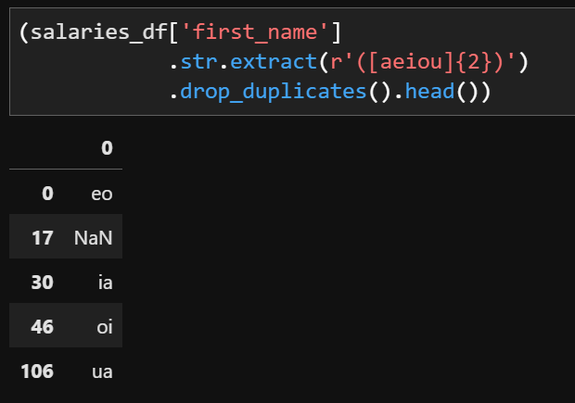
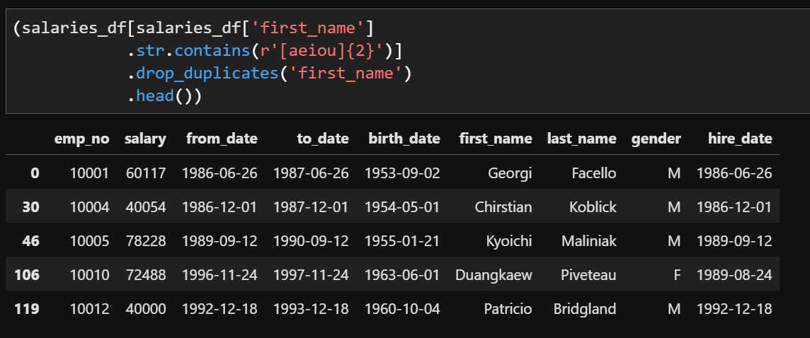
Pandas RegEx

Slide 15
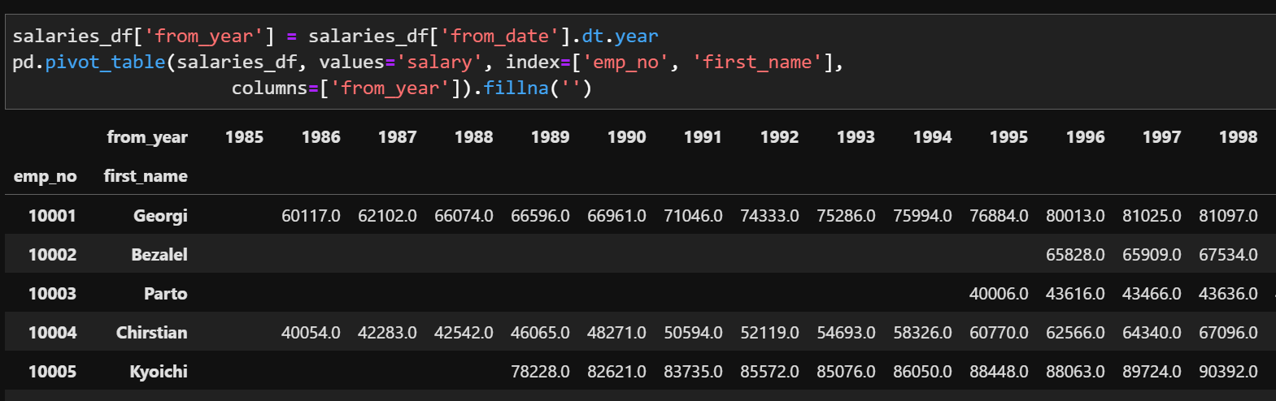
Pandas Pivot

Slide 16
Midterm Practice Problems
Python Basics Review
https://github.com/jcrogel/CSCI-S-101/tree/master/mid_term_review

